Slide 1

Lauren Nichols
MIDS Workshop
September 2023
Notes:
-first step is deciding if ggplot is the right tool
-Brief overview of the strengths and weaknesses of ggplot
-basic grammar
-how to approach making figures in ggplot

Slide 2
Strengths
Data
Integration with analysis in R
Based on Grammar of Graphics
Declarative
Succinct
Versatile
Publication ready graphics
(or at least pretty close to it)
Aesthetics
Geometries
Statistics
Facets
Themes

Slide 3
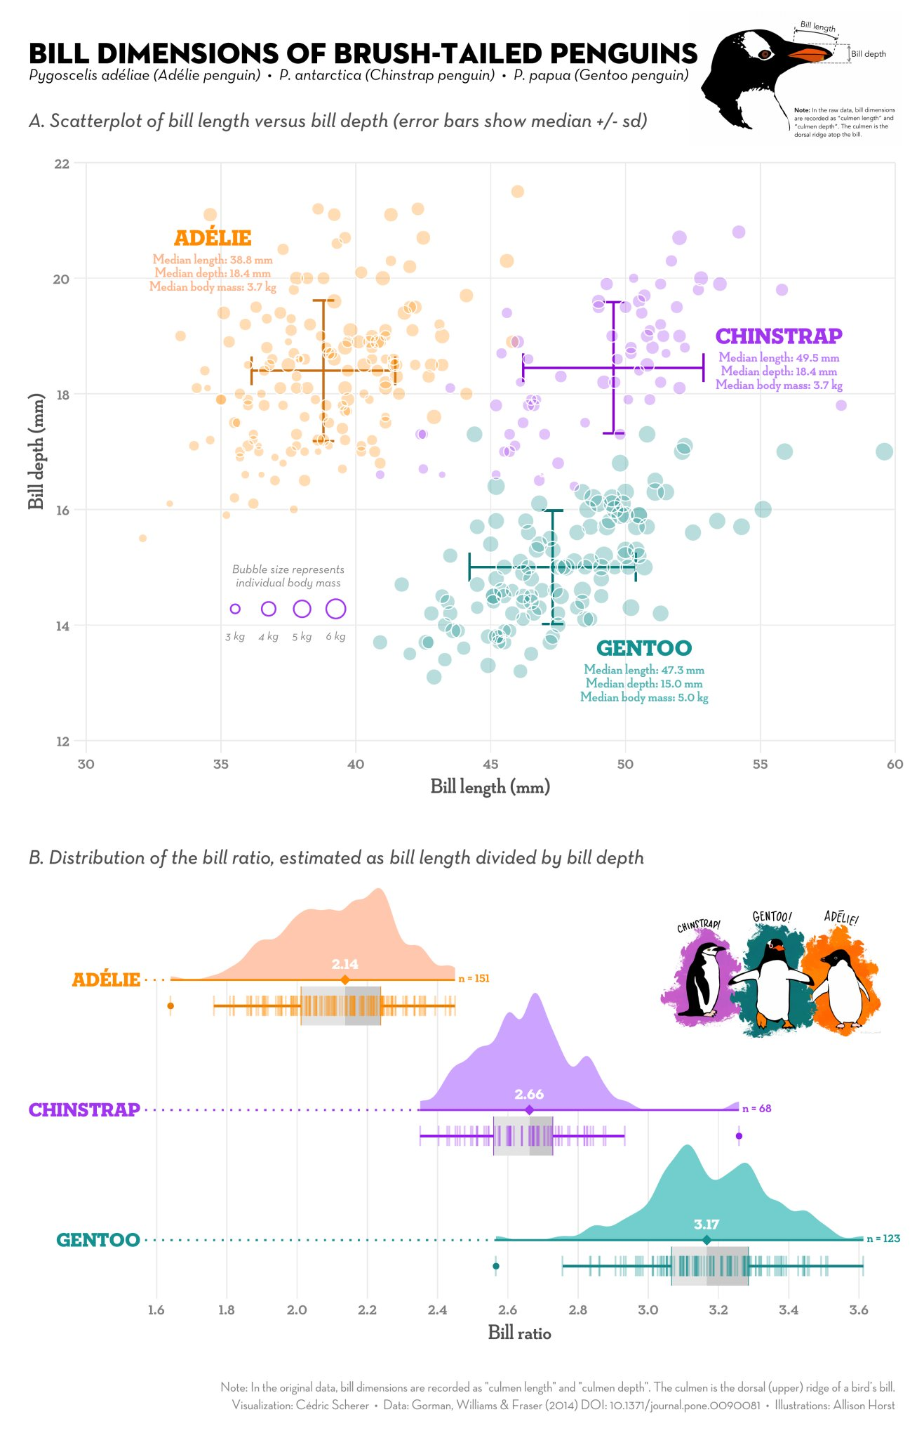

Slide 4
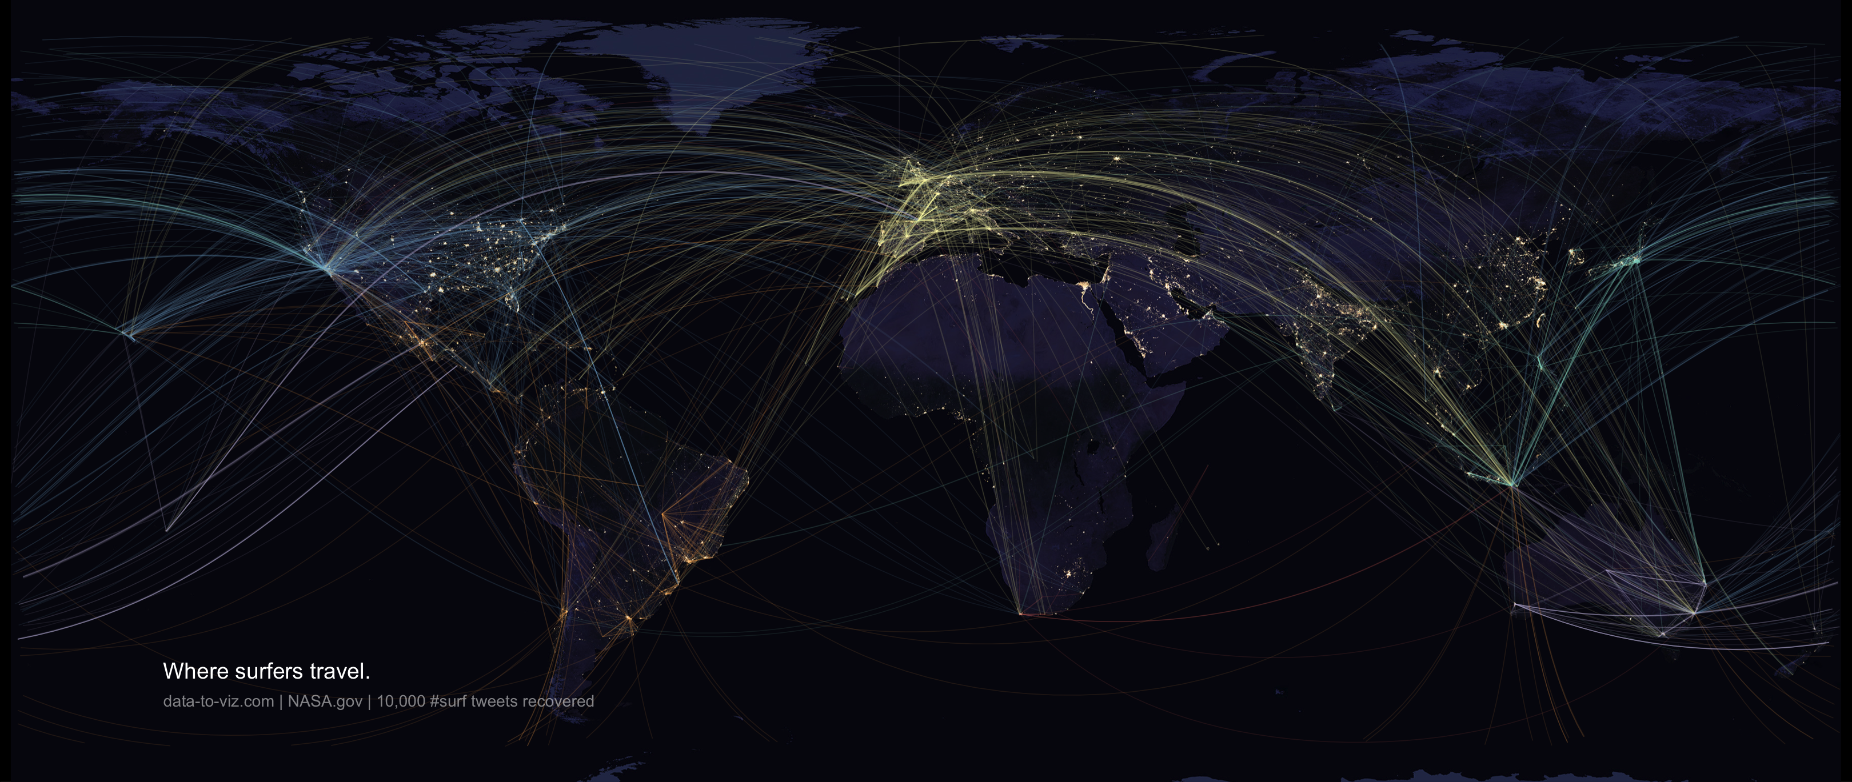

Slide 5
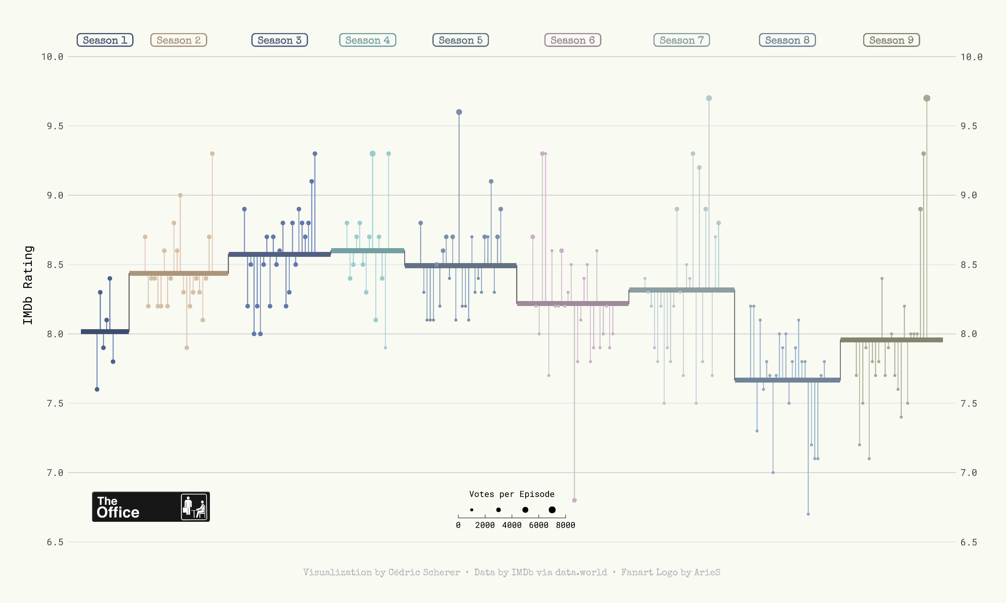

Slide 6
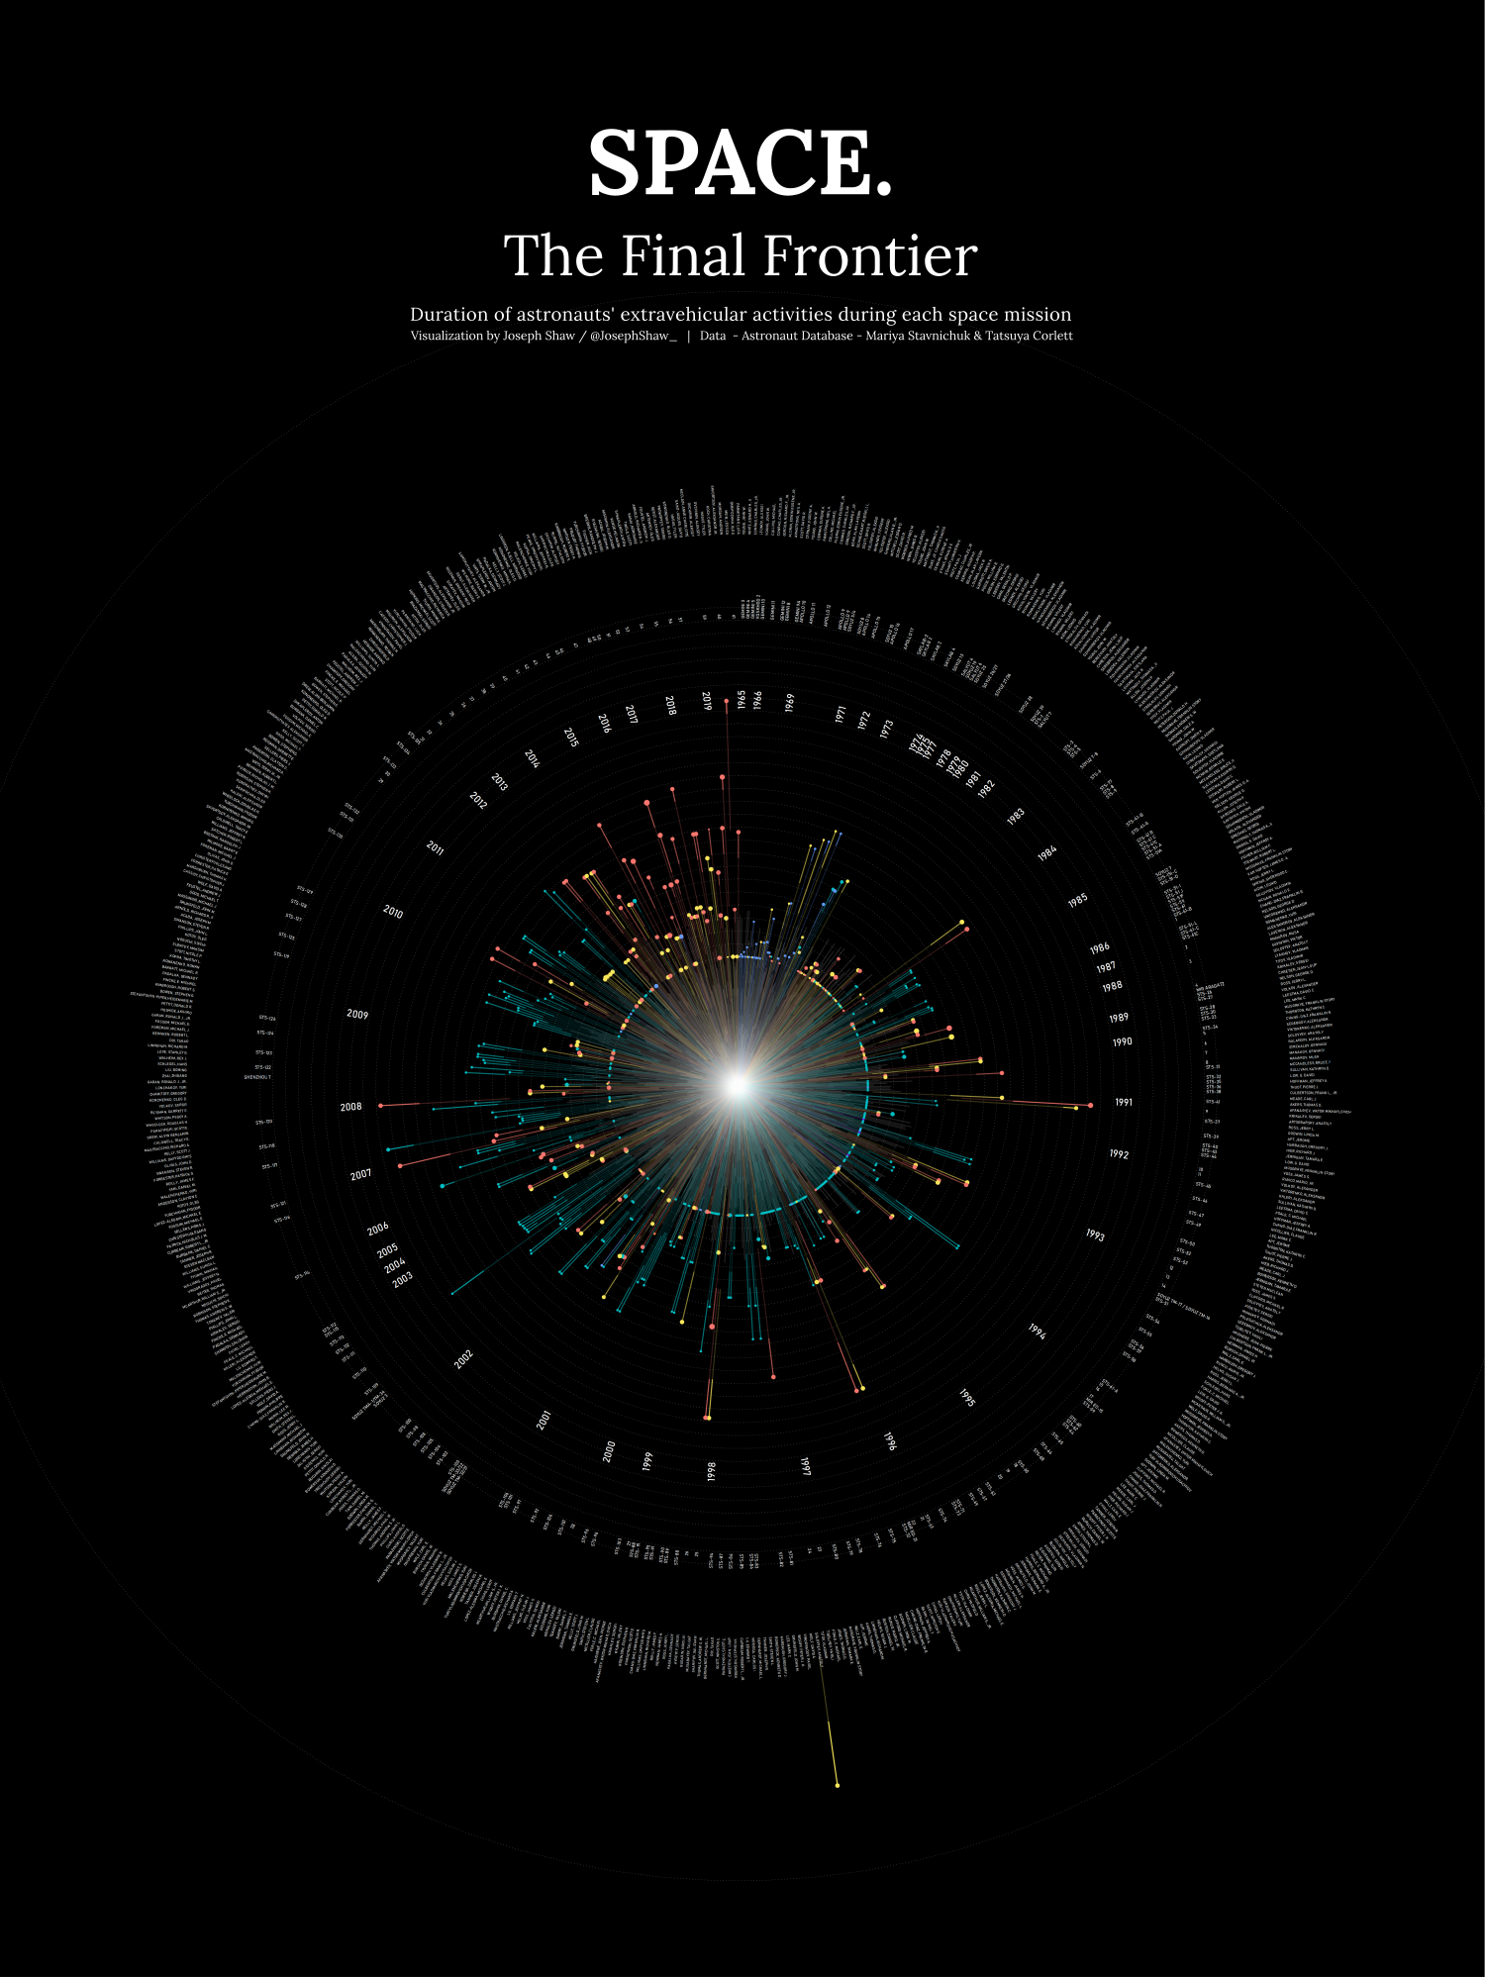
github.com/joseph-shaw/tidytuesday/

Slide 7
Strengths
Weaknesses
Integration with analysis in R
Based on Grammar of Graphics
Declarative
Succinct
Versatile
Publication ready graphics
(or at least pretty close to it)
Not practical if you’re working in another language
Interactivity not well supported

Slide 8
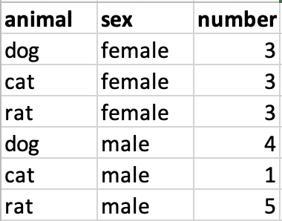
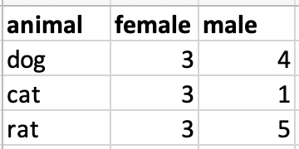
Data Format
Long data (aka. Tidy data)
Wide data

Slide 9
Data Format
Long data
Wide data
f

Slide 10
Data Format
Long data
Wide data
Wide_data = spread(Long_data, sex, number)

Slide 11
Data Format
Long data
Wide data
Long_data = gather(wide_data , sex, number, female:male)

Slide 12
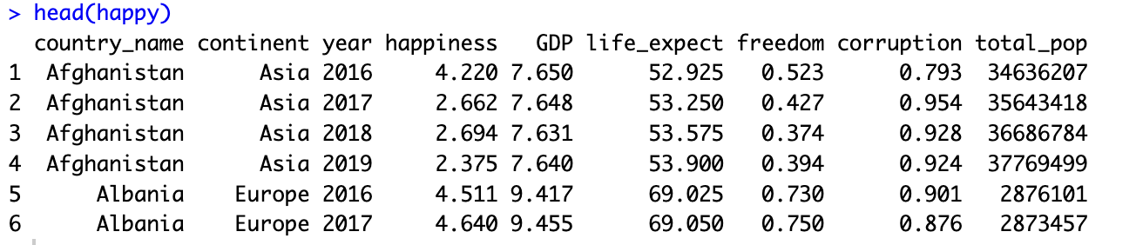

Slide 14
ggplot(data = ,
mapping = aes(x= , ,y= ))+
your data
x axis
y axis
Data
geometry function
Aesthetics
Geometries
Statistics
Facets
Themes
Exporting
Notes:
method chaining with a +

Slide 15
ggplot(data = ,
mapping = aes(x= , ,y= ))+
your data
x axis
y axis
Data
geometry function
Aesthetics
Geometries
Statistics
ggplot(data = ,
mapping = aes(x= , ,y= ))+
happy
happiness
GDP
Facets
geom_point()
Themes
Exporting
Notes:
method chaining with a +

Slide 16
ggplot(data = ,
mapping = aes(x= , ,y= ))+
your data
x axis
y axis
Data
geometry function
Aesthetics
Geometries
Statistics
ggplot(data = ,
mapping = aes(x= , ,y= ))+
happy
happiness
GDP
Facets
geom_point()
Themes
Exporting
Notes:
method chaining with a +

Slide 17
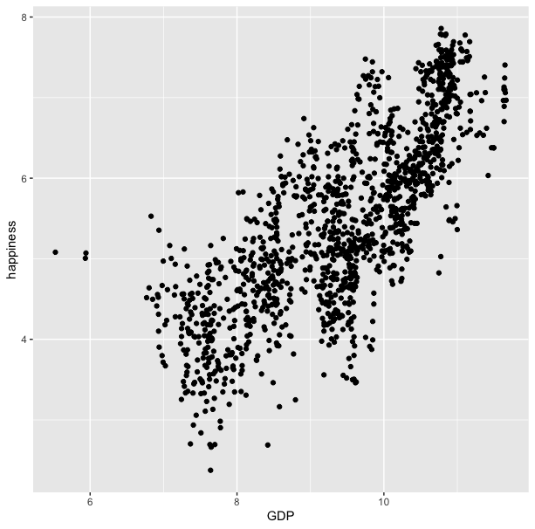
ggplot(data = happy, aes(x=GDP, y=happiness))+
geom_point()

Slide 18
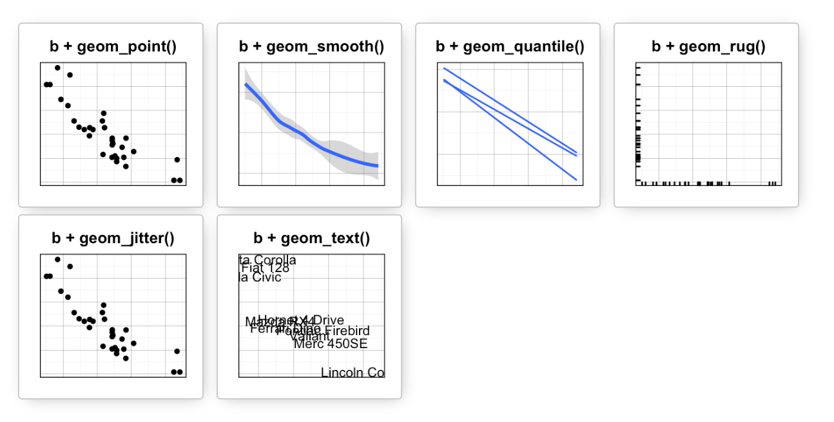
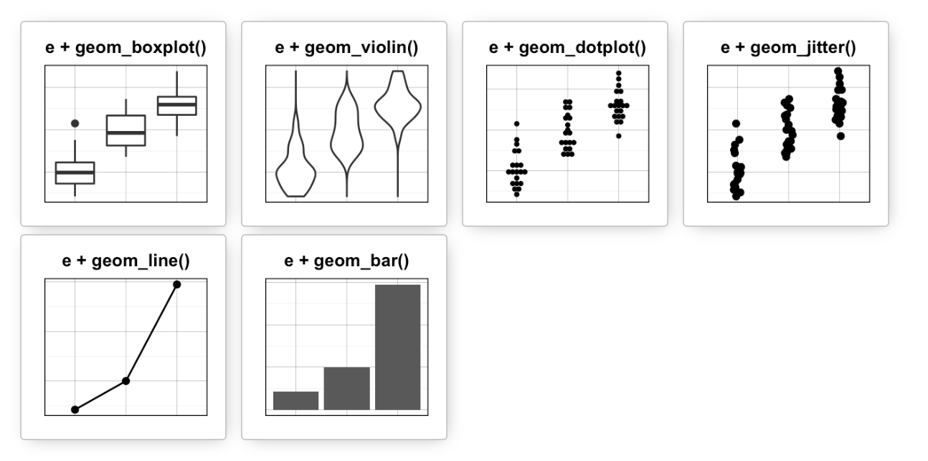
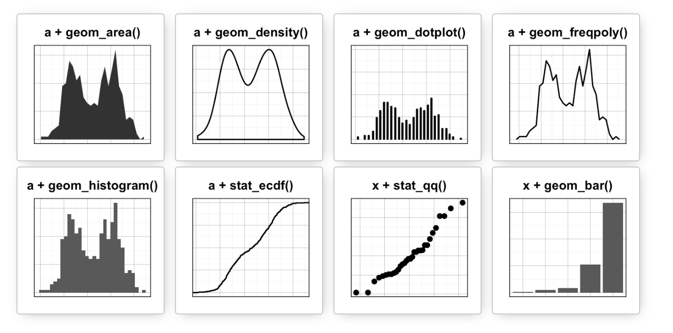
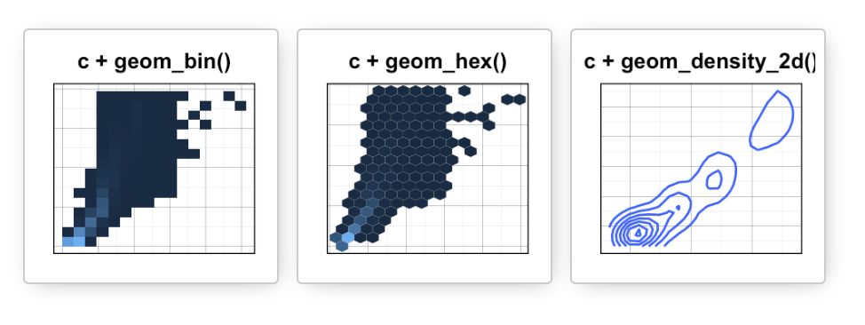
Data
Aesthetics
Geometries
Statistics
Facets
Themes
Exporting

Slide 19
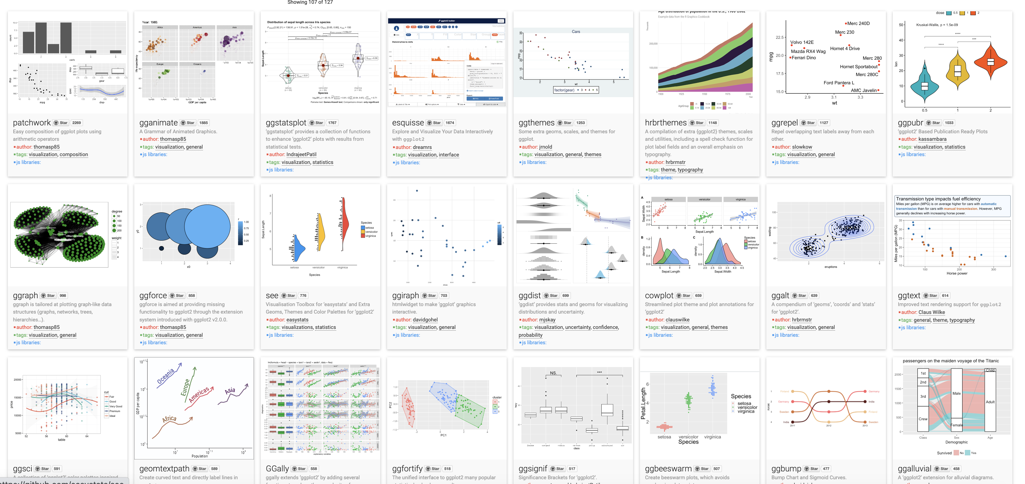
Over 120 ggplot2 extension libraries

Slide 20
ggplot(data = happy, aes(x=GDP, y=happiness))+
geom_point()
“and then…”
dplyr %>% or |>
ggplot +

Slide 21
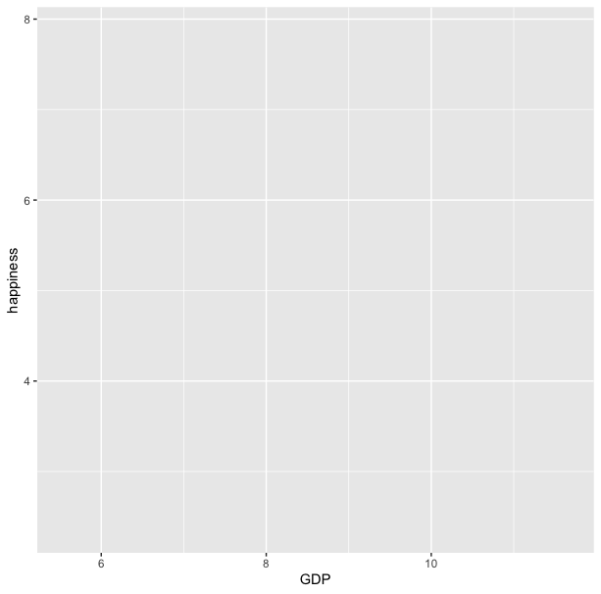
ggplot(data = happy, aes(x=GDP, y=happiness))

Slide 22
ggplot(data = happy, aes(x=GDP, y=happiness))+
geom_point()

Slide 23
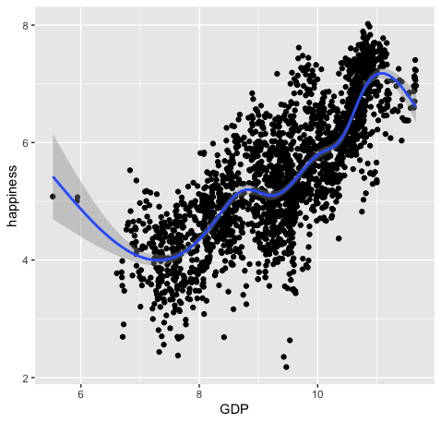
ggplot(data = happy, aes(x=GDP, y=happiness))+
geom_point()+
geom_smooth()

Slide 24
ggplot(data = happy,
mapping = aes(x=GDP, y=happiness))+
geom_point()

Slide 25
ggplot(data = happy,
mapping = aes(x=GDP, y=happiness))+
geom_point()
ggplot(happy, aes(GDP, happiness))+
geom_point()

Slide 26
ggplot(data = happy,
mapping = aes(x=GDP, y=happiness))+
geom_point()
ggplot(happy, aes(GDP, happiness))+
geom_point()
ggplot()+
geom_point(happy,aes(GDP,happiness))

Slide 27
ggplot(data = happy,
mapping = aes(x=GDP, y=happiness))+
geom_point()
ggplot(happy, aes(GDP, happiness))+
geom_point()
ggplot()+
geom_point(happy,aes(GDP,happiness))
happy %>%
ggplot(aes(GDP,happiness))+
geom_point()

Slide 28
ggplot(data = happy,
mapping = aes(x=GDP, y=happiness))+
geom_point()
ggplot(happy, aes(GDP, happiness))+
geom_point()
ggplot()+
geom_point(happy,aes(GDP,happiness))
happy %>%
ggplot(aes(GDP,happiness))+
geom_point()
These all produce the same figure!

Slide 29
Aesthetics define any data that gets mapped to geometry
(such as color, size, shape, etc.)
Data
Aesthetics
Geometries
Statistics
ggplot(data = yourData,
aes(x = xaxis,y = yaxis))+
geom_point()
Facets
Themes
Exporting
Notes:
method chaining with a +

Slide 30
Aesthetics define any data that gets mapped to geometry
(such as color, size, shape, etc.)
Data
Aesthetics
Geometries
Statistics
ggplot(data = happy,
aes(x = happiness,y = GDP))+
geom_point()
ggplot(data = yourData,
mapping = aes(x = xaxis,y = yaxis))+
geom_point()
Facets
Themes
Exporting
Notes:
method chaining with a +

Slide 32
ggplot(happy, aes(GDP, happiness)) +
geom_point()

Slide 33
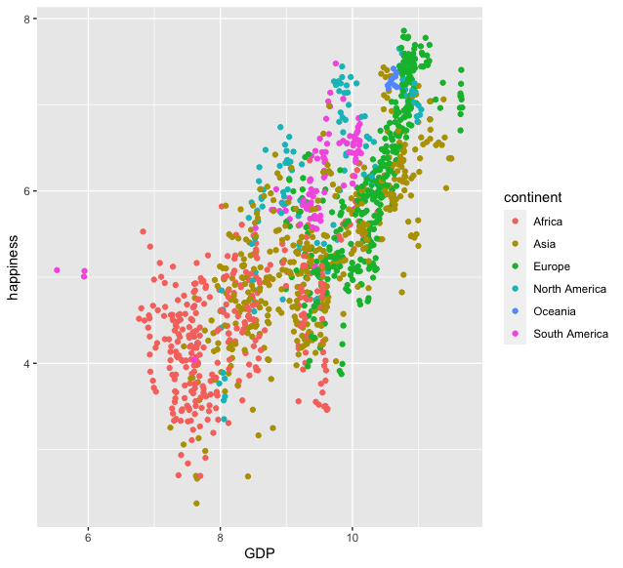
ggplot(happy, aes(GDP, happiness)) +
geom_point(aes(col=continent))

Slide 34
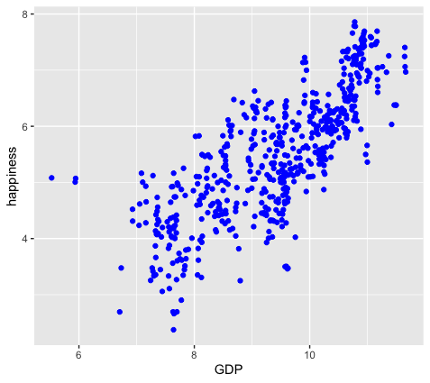
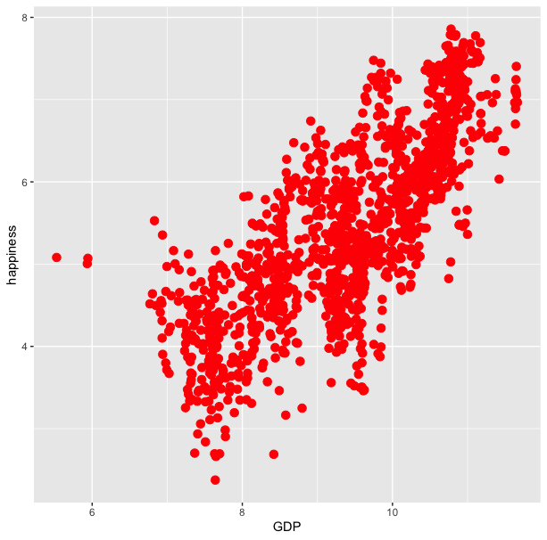
ggplot(happy, aes(GDP, happiness)) +
geom_point(aes(col=continent))
ggplot(happy, aes(GDP, happiness)) +
geom_point(col=‘blue’)

Slide 35
ggplot(happy, aes(GDP, happiness)) +
geom_point(aes(col=continent))
ggplot(happy, aes(GDP, happiness)) +
geom_point(col=‘blue’)
ggplot(happy, aes(GDP, happiness)) +
geom_point(aes(col=‘blue’))

Slide 36
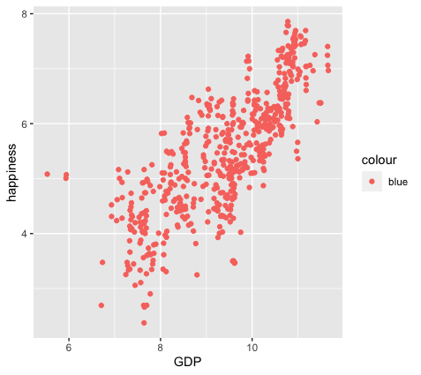
ggplot(happy, aes(GDP, happiness)) +
geom_point(aes(col=continent))
ggplot(happy, aes(GDP, happiness)) +
geom_point(col=‘blue’)
ggplot(happy, aes(GDP, happiness)) +
geom_point(aes(col=‘blue’))

Slide 37
colour
blue
blue
blue
blue
blue
blue
ggplot(happy, aes(GDP, happiness)) +
geom_point(aes(col=‘blue’))

Slide 38
ggplot(happy, aes(GDP, happiness)) +
geom_point()
We can also set conditional formatting.
e.g. Use different colors for points where happiness is > 5

Slide 39
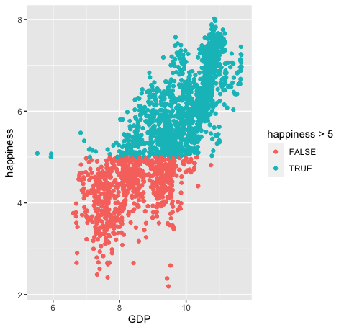
ggplot(happy, aes(GDP, happiness)) +
geom_point()
ggplot(happy, aes(GDP, happiness)) +
geom_point(aes(col=happiness > 5)

Slide 40
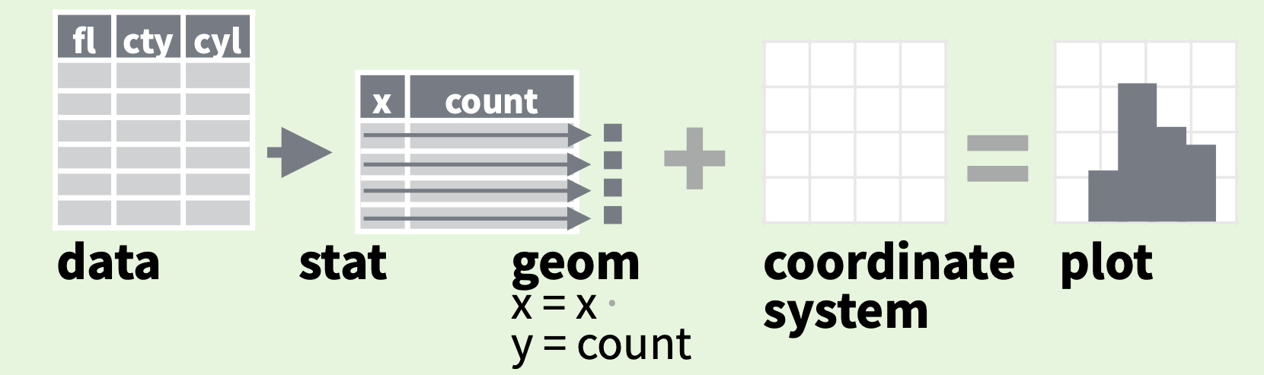
Data
Aesthetics
Geometries
Statistics
Facets
Themes
Exporting

Slide 41
Every geom function specifies a stat
Use a stat function (calls a default geom to make a layer)
Data
Aesthetics
Geometries
Statistics
Facets
Themes
Exporting

Slide 42
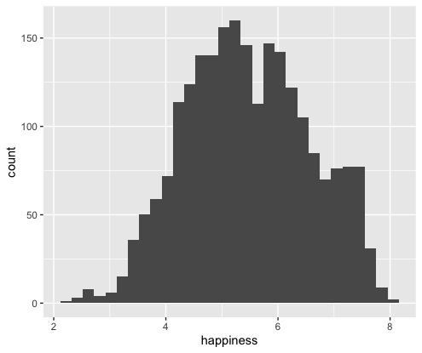
Every geom function specifies a stat
Use a stat function
(calls a default geom to make a layer)
ggplot(happy, aes(happiness)) +
geom_histogram()

Slide 43
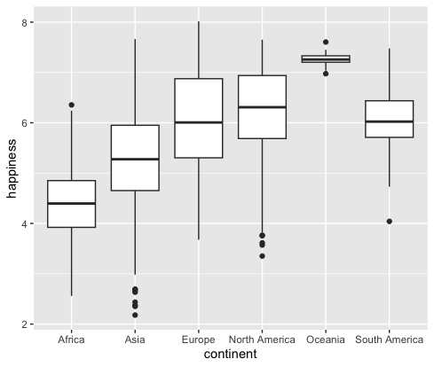
Every geom function specifies a stat
Use a stat function
(calls a default geom to make a layer)
ggplot(happy, aes(continent, happiness)) +
geom_boxplot()

Slide 44
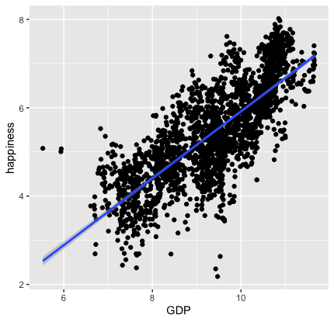
Every geom function specifies a stat
Use a stat function
(calls a default geom to make a layer)
ggplot(happy, aes(GDP, happiness)) +
geom_point()+
stat_smooth(method = "lm",
formula = y ~ x)

Slide 45
Data
Aesthetics
Geometries
Statistics
Facets
Themes
Exporting

Slide 46
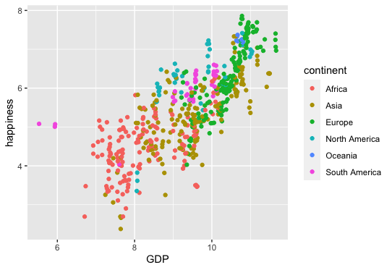
ggplot(happy, aes(GDP, happiness))+
geom_point(aes(col=continent))

Slide 47
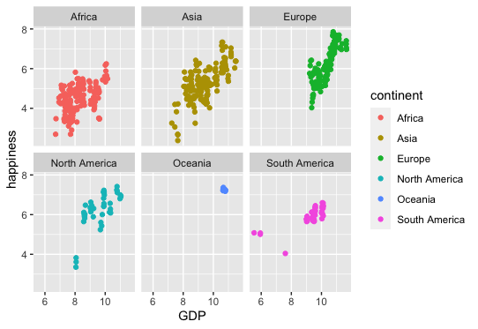
ggplot(happy, aes(GDP, happiness))+
geom_point(aes(col=continent))
ggplot(happy, aes(GDP, happiness))+
geom_point(aes(col=continent))+
facet_wrap(~continent)

Slide 48
ggplot(happy, aes(GDP, happiness))+
geom_point(aes(col=continent))
ggplot(happy, aes(GDP, happiness))+
geom_point(aes(col=continent))+
facet_wrap(~continent)

Slide 49
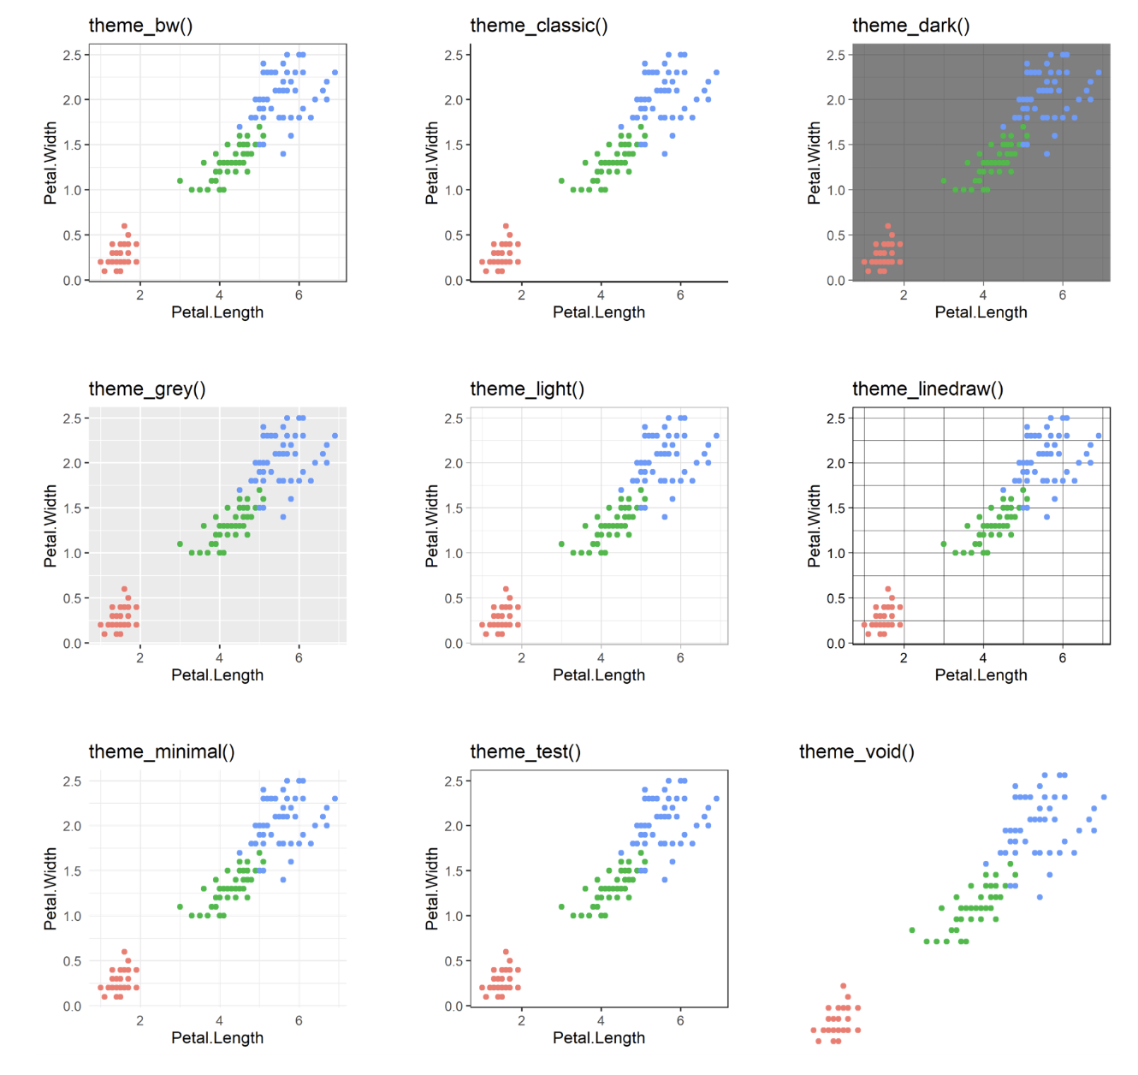
60 preexisting themes
easy to call
Data
Aesthetics
Geometries
Statistics
Facets
Themes & scales
Exporting

Slide 50
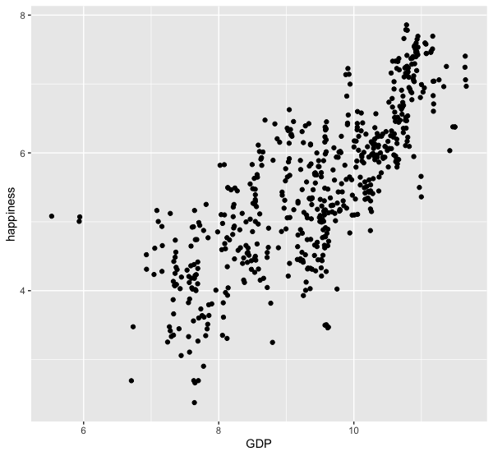
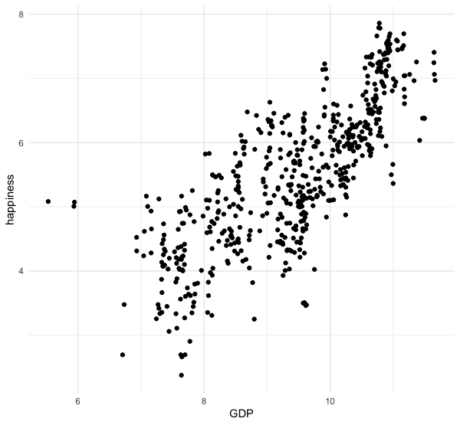
ggplot(happy, aes(GDP, happiness))+
geom_point()
ggplot(happy, aes(GDP, happiness))+
geom_point()+
theme_minimal()

Slide 51
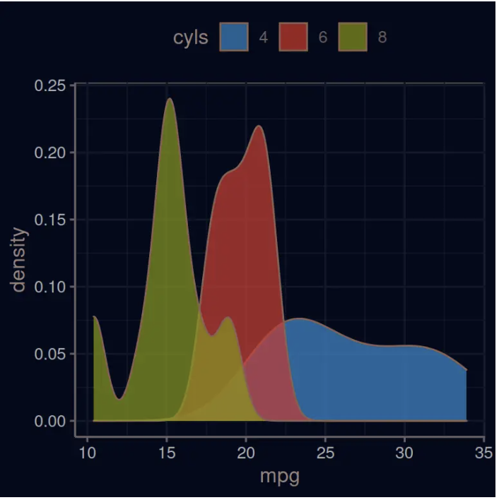
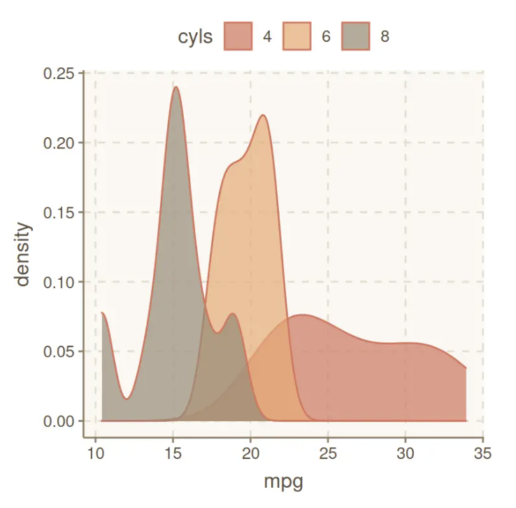
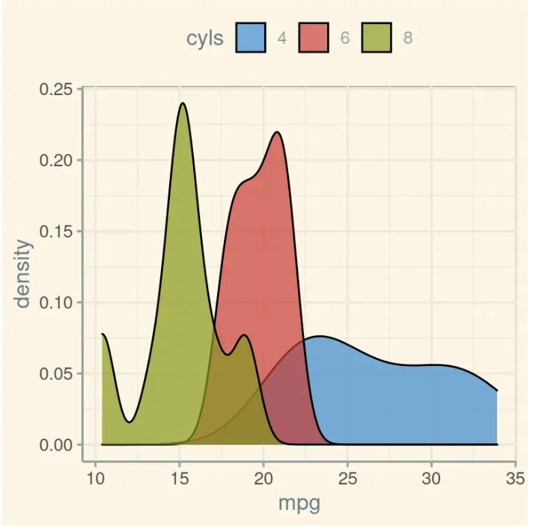
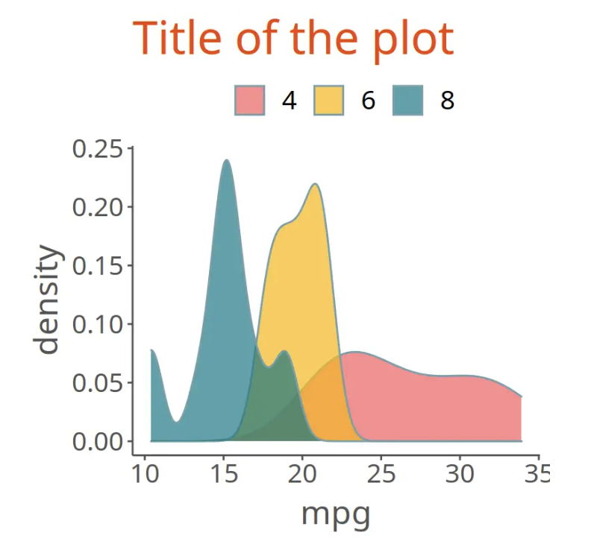
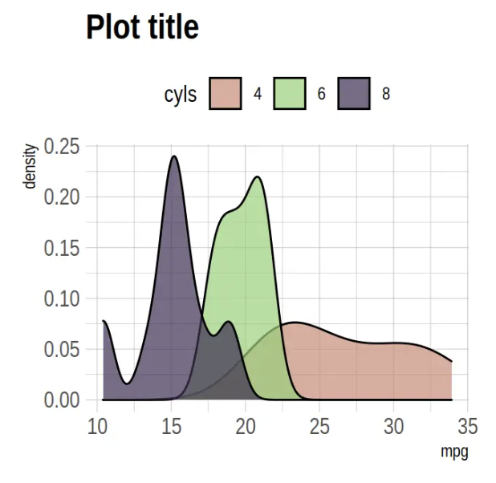
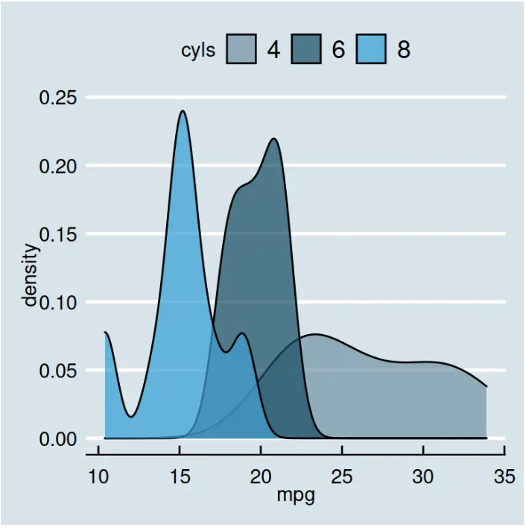
Over 60 pre-existing themes
Data
Aesthetics
Geometries
Statistics
Facets
Themes & scales
Exporting
https://r-charts.com/ggplot2/themes/

Slide 52
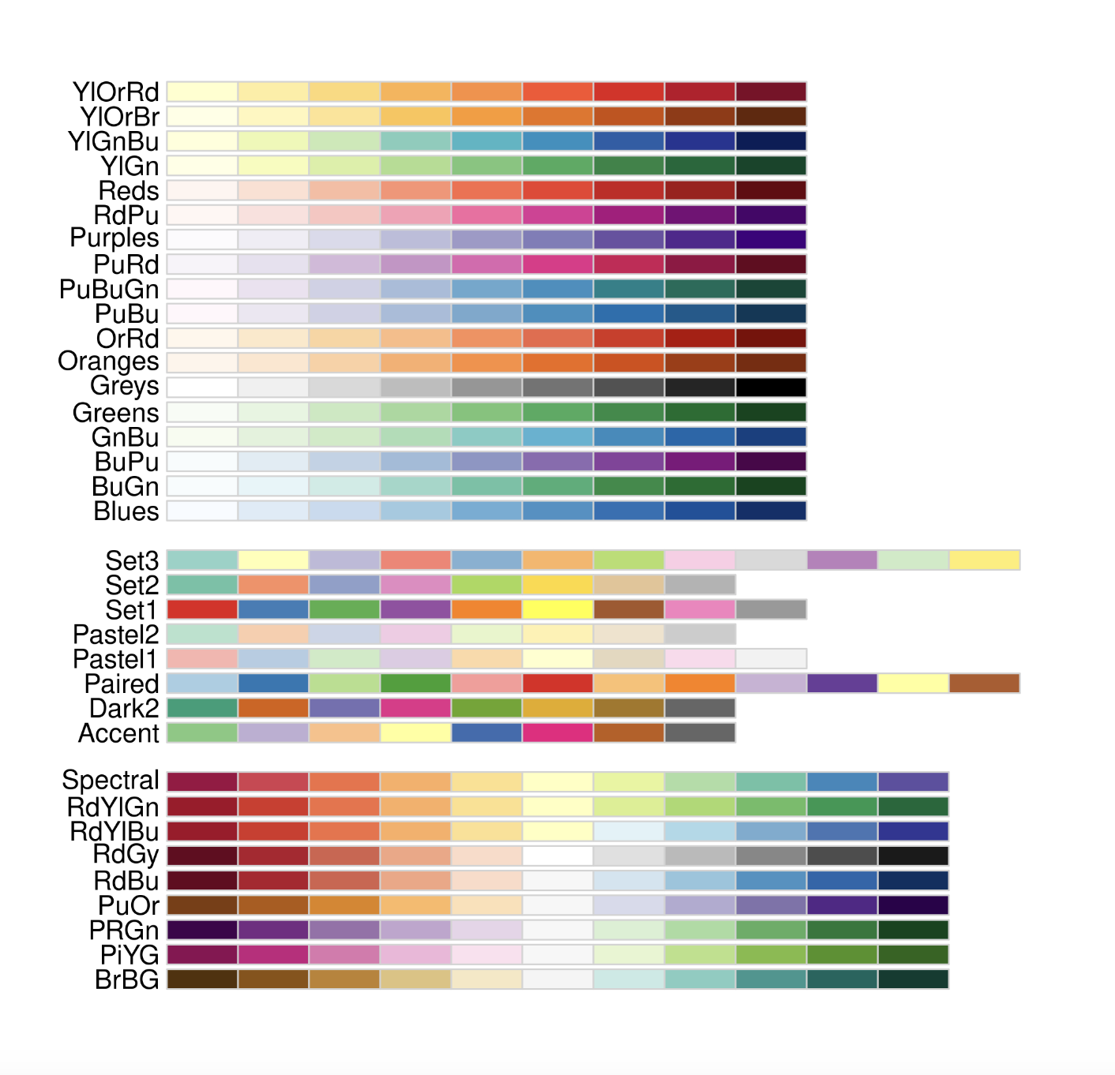
Brewer Scales
Data
Aesthetics
Geometries
Statistics
Facets
Themes & scales
Exporting

Slide 53
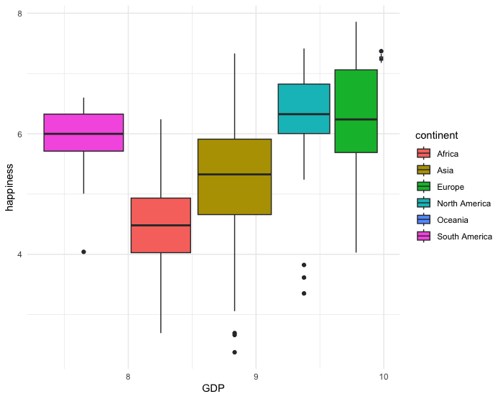
Brewer Scales
ggplot(happy, aes(GDP, happiness))+
geom_boxplot(aes(fill=continent)) +
theme_minimal

Slide 54
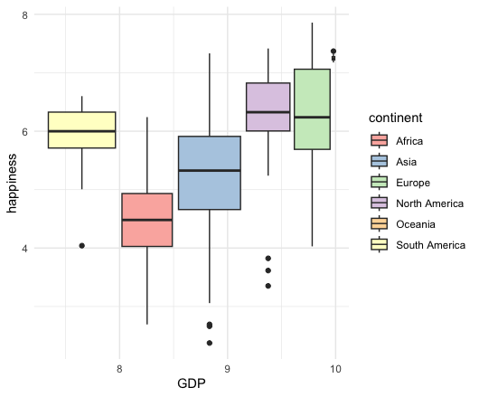
Brewer Scales
ggplot(happy, aes(GDP, happiness))+
geom_boxplot(aes(fill=continent)) +
theme_minimal()+
scale_fill_brewer(palette = "Set3")

Slide 55
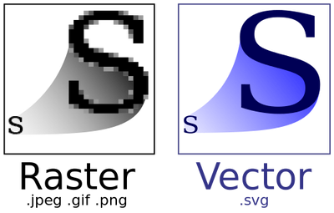
Data
Aesthetics
Geometries
Statistics
Facets
.pdf
Themes
Exporting

Slide 56
Lets give it a try

